Slide 1
Greedy Algorithm

Slide 2
What is Greedy Algorithm?
A greedy algorithm always makes the choice that seems to be the best at that moment. This means that it makes a locally-optimal choice in the hope that this choice will lead to a globally-optimal solution.

Slide 3
Activity Selection Problem
Problem Statement : You are given n activities with their start and finish times. Select the maximum number of activities that can be performed by a single person, assuming that a person can only work on a single activity at a time.
Input : arr[] = {{5,9},{1,2},{3,4},{0,6},{5,7},{8,9}}

Slide 4
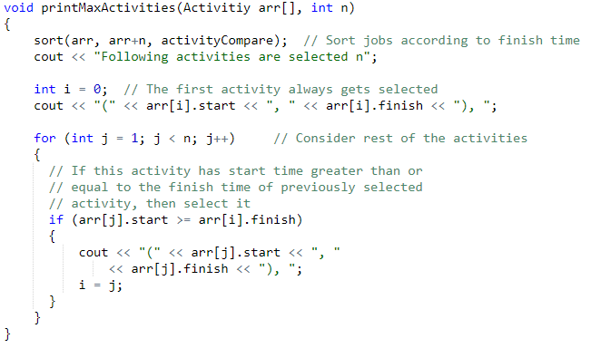
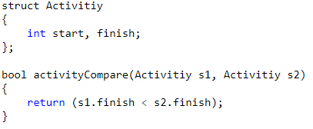
Implementation:

Slide 5
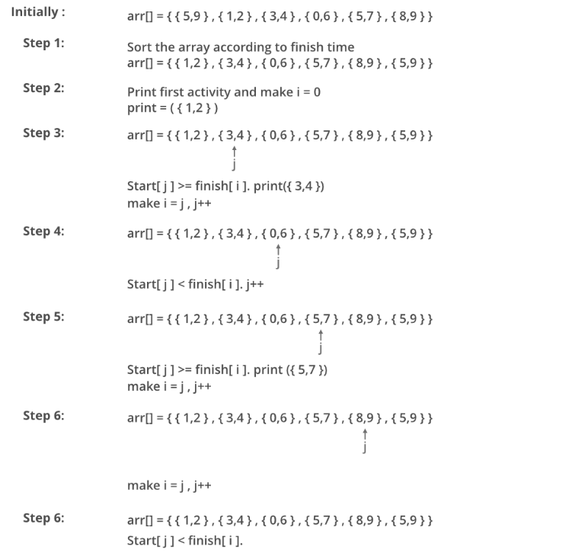

Slide 6
Fractional Knapsack Problem:
Given weights and values of n items, we need to put these items in a knapsack of capacity W to get the maximum total value in the knapsack. Here, we can break items for maximizing the total value of knapsack.
The basic idea of the greedy approach is to calculate the ratio value/weight for each item and sort the item on basis of this ratio. Then take the item with the highest ratio and add them until we can’t add the next item as a whole and at the end add the next item as much as we can. Which will always be the optimal solution to this problem.

Slide 7
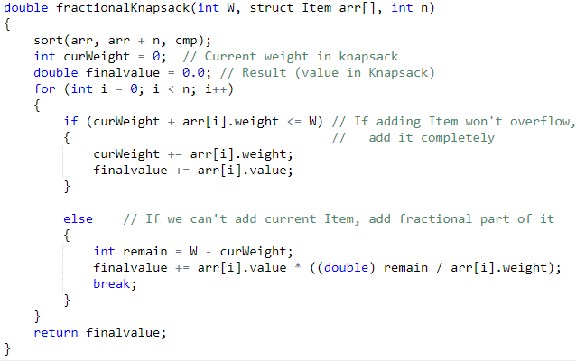
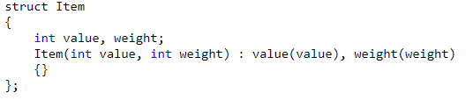
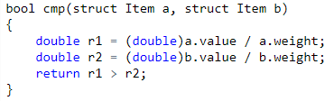
Implementation:

Slide 8
Practice Problems:
https://leetcode.com/problems/best-time-to-buy-and-sell-stock-ii/
https://leetcode.com/problems/task-scheduler/

